Slide 1
Relevance Feedback
Dik Lun LEE Department of Computer Science, HKUST Slide <number>

Slide 2
Document Retrieval Model
User feedback
Query reformulation
Relevance Feedback
Document modification
Query Term weight adjustment
Retrieved
documents
Document Term weight adjustment
Query formulation
Formal language
Retrieval
Document representation
Indexing
User’s information need
Documents
Dik Lun LEE Department of Computer Science, HKUST Slide <number>

Slide 3
Why Good Search Quality is Hard to Get?
Users type in only 1-2 keywords
  Hardly enough to indicate what the user really wants
Ambiguity in words:
  Different words may mean the same thing (synonyms)
  Same word may have different meanings
    What does “apple” mean?
    What does “IR” mean?
No way to find out what the user really wants without additional help
Dik Lun LEE Department of Computer Science, HKUST Slide <number>

Slide 4
Query Reformulation
Query reformulation modifies a bad query into a better one:
apple → apple ipod | Adding specific terms to disambiguate a query
apple iphone → iphone | Removing general terms
… | …
Dik Lun LEE Department of Computer Science, HKUST Slide <number>

Slide 5
Manual vs Automatic Feedback
Manual query reformulation is difficult
  Users do not know what makes a document relevant (or irrelevant) without examining the results in detail and understanding the retrieval method
  Document characteristics are not easily transformed into correct query formulations
  Users are not willing to do it even if they know how to do it
Automatic relevance feedback -- automatically generating new query formulations based on relevance assessments from the users during earlier search operation
Dik Lun LEE Department of Computer Science, HKUST Slide <number>

Slide 6
Implicit versus Explicit Feedback
Explicit:
  Users explicitly identify which documents are relevant and which are not relevant
Implicit:
  System provides additional information to help users narrow into the desirable results
  Google and Altavista: “similar pages” or “related pages” button associated with each result
  Vivisimo, wisenut, taeoma: presents related keywords and groups of documents for users to choose
Dik Lun LEE Department of Computer Science, HKUST Slide <number>

Slide 7
Implicit Feedback by “Related Queries” Suggestions
Google and Altavista [tested on Apr 16, 2002]:
  Search “hkust” returns many HKUST pages (note that search engine has no idea that HKUST is a university)
  Click “similar pages” returns other universities in Hong Kong (HKU, etc.)
  Implicitly, user told search engine that HKUST is a university
Vivisimo:
  Suggested categories: “Hong Kong University of Science and Technology”, “Engineering”, “Supply Chain”, …, “District” (wrong!)
  Draw suggestions from directories (e.g., yahoo!, MSN, etc.)
Wisenut:
  Suggested keywords: “Kong University”, “Center HKUST”, “HKUST Library”
Teoma:
  Suggested keywords: “Hong Kong University”, “HKUST Staff”
  Suggested phrases are “ANDed” with the original query
Dik Lun LEE Department of Computer Science, HKUST Slide <number>

Slide 8
Query Modification Process
Relevancy
judgement
Ranked
output
Rel. & nonrel.
documents
Reformulated
query Q’
Original
query Q
Retrieval
Process
F
G
F: accepts relevance judgement from the user and produces as output sets of relevant and nonrelevant documents
G: implements the feedback formula (for rewriting the original query)
Dik Lun LEE Department of Computer Science, HKUST Slide <number>

Slide 9
The Effect of Relevance Feedback
Relevant documents
x
Nonrelevant documents
x
x
x
x
Original query
Original query retrieved
five documents
Reformulated query
Dik Lun LEE Department of Computer Science, HKUST Slide <number>

Slide 10
The Basic Idea of Query Modification
Terms in relevant results are used to reinforce the original query vector
  If the term does not exist in the query, it should be added
  If the term is already in the query, its weight should be increased
  Search <apple>: user identifies a page containing “apple” and “iPod” as relevant, then revised query should be <apple, iPod>
Terms in nonrelevant results are used to weaken the original query vector
  If a term does not exist in the query, it should be added with a negative weight
  If a term is already in the query, its weight should be decreased
  Search <apple, computer>: the user identifies a page containing “Dell” and “computer” as irrelevant, revised query should reduce the weight of (or eliminate totally) “computer”
 |  | apple | dell | computer | ipod | juice
… … apple … ipod … | √ | ↑ |  |  | ↑
… … apple … juice … | × | ↓ |  |  |  | ↓
… … dell … computer … | × |  | ↓ | ↓
Q’:
apple ∼
ipod ↑
dell↓
computer ↓
juice ↓
Q: apple computer
Dik Lun LEE Department of Computer Science, HKUST Slide <number>

Slide 11
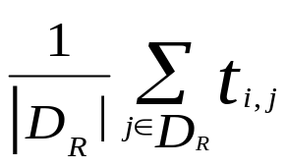
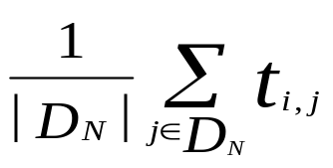
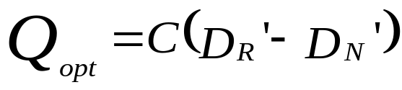
Optimal Query
Given known relevant and nonrelevant document sets, D_{R} and D_{N} , obtain the centroids D_{R}′ and D_{N} ′. That is, let t_{i,j} represent the weight of term i in document j, then the average weight of term i in the two centroids are:
and
and the optimal query Q_{opt} can be defined as
where C is an arbitrary weighting constant for the optimal query vector
Issue: D_{R} and D_{N} are unknown
Consider different cases:
If t_{k} only appears in rel docs, its weight is very high
If t_{k} only appears in nonrel docs, its weight should be small or even negative
If t_{k} appears in both rel and nonrel docs, its weight is somewhere in the middle
Dik Lun LEE Department of Computer Science, HKUST Slide <number>

Slide 12
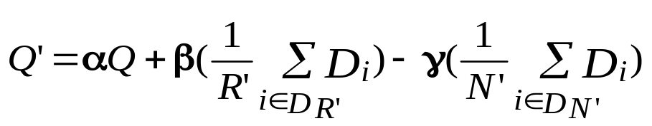
Query Modification
Note that previous optimal formulation is based on knowing complete sets of relevant and nonrelevant documents, but relevance feedback only tell you some of the relevant and nonrelevant documents.
Using the previously identified relevant and nonrelevant document set D_{R’} and D_{N’} as an estimate of D_{R} and D_{N} to repeatedly modify the query to reach optimality
Starting with an initial query in the form of
where Q is the original query, α, β, and γ are suitable constants
Dik Lun LEE Department of Computer Science, HKUST Slide <number>

Slide 13
What does the Formula Mean?
User identifies relevant and nonrelevant document sets D_{R’} and D_{N’}
Repeatedly modify the query based on:
where Q is the original query, α, β, and γ are suitable constants
D_{R’}
D_{N’}
Q
Dik Lun LEE Department of Computer Science, HKUST Slide <number>

Slide 14
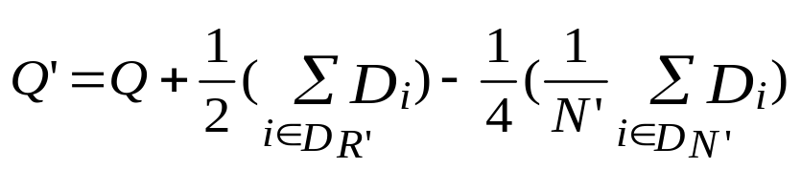
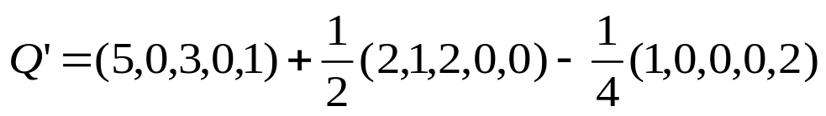
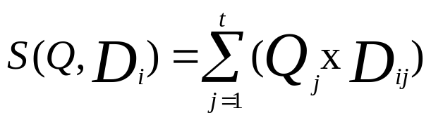

An Example
T1 T2 T3 T4 T5
Q = ( 5, 0, 3, 0, 1)
D1 = ( 2, 1, 2, 0, 0)
D2 = ( 1, 0, 0, 0, 2)
Q: original query
D1: relevant doc.
D2: nonrelevant doc.
α = 1, β = 1/2, γ = 1/4
Assume:
S(Q,D1) = (5•2)+(0 • 1)+(3 • 2)+(0 • 0)+(1 • 0) = 16
S(Q’D1)=(5.75 • 2)+(0.5 • 1)+(4 • 2)+(0 • 0)+(0.5 • 0)=20
S(Q,D2) = (5•1)+(0 • 0)+(3 • 0)+(0 • 0)+(1 • 2) = 7
S(Q’D2)=(5.75 • 1)+(0.5 • 0)+(4 • 0)+(0 • 0)+(0.5 • 2)=6.75
Dik Lun LEE Department of Computer Science, HKUST Slide <number>

Slide 15
Parameters To Be Determined
What are the values of α, β, and γ ?
  Only consider relevant documents -- positive mode
  only consider nonrelevant documents -- negative mode
  equally/differently weighted -- mixed mode
How many documents to use in R’ and N’
  use all relevant and nonrelevant documents
  use all relevant documents and highest-ranked nonrelevant documents
Should the entire document vector be used
  definitely not!
    use only high-weight terms (representatives of the document contents)
    use only common terms in all R’ or N’ (even stronger requirement: a term is important in retrieving relevant documents if it appears in all relevant documents, same for irrelevant documents)
Dik Lun LEE Department of Computer Science, HKUST Slide <number>

Slide 16
Observations
It is found that the information contained in the relevant documents is more valuable for query modification purposes than the terms which originate in the nonrelevant items.
  Relevant documents are expected to be located in a reasonable homogeneous areas of document space, while nonrelevant documents are normally much more heterogeneous.
  Use smaller weight for γ than for β.
Dik Lun LEE Department of Computer Science, HKUST Slide <number>

Slide 17
Effectiveness of Relevance Feedback
Ideal: rel and nonrel
docs are clearly separated
relevant documents
x
nonrelevant documents
x
x
original query
x
x
x
reformulated query
Hopeless: rel and nonrel
docs are mixed together
x
x
x
x
x
x
x
x
x
x
OK: relevant docs
still form a cluster
What is the problem with this document space?
Dik Lun LEE Department of Computer Science, HKUST Slide <number>

Slide 18
Document Retrieval Model
User feedback
Query reformulation
Relevance Feedback
Document modification
Query Term weight adjustment
Retrieved
documents
Document Term weight adjustment
Query formulation
Formal language
Retrieval
Document representation
Indexing
User’s information need
Documents
Dik Lun LEE Department of Computer Science, HKUST Slide <number>

Slide 19
Document Space Modification
Instead of modifying the user query, the document vectors (i.e., the index terms and weights of the documents) are modified according to user feedback. (See example on next slide)
Idea: Move relevant document vectors closer to the query and nonrelevant document vectors farther from the query.
Dik Lun LEE Department of Computer Science, HKUST Slide <number>

Slide 20
Examples of Document Space Modification
relevant documents
nonrelevant documents
query
Relevant document modification
Relevant and nonrelevant document modification
Dik Lun LEE Department of Computer Science, HKUST Slide <number>

Slide 21
Relevant Document Modification
Documents designated as relevant must be rendered more similar to query Q
  A query term not present in the document is added to the document with a weight factor α.
  A query term present in the document receives increased importance by incrementing its weight by a factor β.
  A document term not present in the query is decreased in weight by -γ.
By making document vectors more similar to a common query, they are also made more similar to each other.
When queries are evaluated, the document space changes constantly. Would the document space “adapt” to give best overall performance?
Dik Lun LEE Department of Computer Science, HKUST Slide <number>

Slide 22
Nonrelevant Document Modification
Documents designated as nonrelevant must be rendered less similarity to the query
Document terms also present in the query are rendered less important by decreasing their weight by a factor of -δ.
Document terms absent from the query are increased in weight by a factor of ε.
Example:
Query: investment bond
Returned Doc: “We invested a lot of time in this project…”
  Making this document irrelevant reduces the weight of “invest” and increases the weight of project in the document
Dik Lun LEE Department of Computer Science, HKUST Slide <number>

Slide 23
Document Modification in Practice
Document modification sounds great, but is it practical … ?
  It has a global and persistent impact on future queries
  Should a search engine modify documents they didn’t create?
Let’s take a broad view of what a “document” is:
metatag
metatag
metatag
page
page
page
page
Keywords
+metatags
Keywords
+metatags
Keywords
Keywords
+metatags
Access pattern
Query terms
Dwell time
Clicks … …
Link matrix
Link matrix
Dik Lun LEE Department of Computer Science, HKUST Slide <number>

Slide 24
Document Modification in Practice
An editor may enter additional keywords (metatags) along with an article to enhance searching (static)
What makes the “index” changes all the time:
  Keep track of user access, increase ranks of popular pages/sites
    Most search engines record the result items users click on
  Keep track of popular pages by counting incoming links i.e., even if a page is not updated, its ranking may be affected by others
Document scores depend on the above factors (plus many others)
Dik Lun LEE Department of Computer Science, HKUST Slide <number>

Slide 25
Effects of Document Space Modification
The operation affects the document vectors permanently. Therefore, each movement must be small enough so that a single erroneous movement (i.e., due to erroneous judgement or malicious user actions) won’t affect the collection too much.
Documents adapt to user feedback. Documents not identified as relevant by any user tend to cluster together. Thus, the method can be used as a document retirement policy
  Those documents that have never been retrieved or, are always identified as nonrelevant or retrieved late in a search may be deleted or moved to tertiary storage medium (e.g., tapes)
Results of queries are not repeatable since the document space may have been changed
Dik Lun LEE Department of Computer Science, HKUST Slide <number>

Slide 26
Practical Problems
Query splitting and document space modification are rarely used in document retrieval systems because:
  Query splitting requires the user to specify a large number of relevant documents in order for cluster identification to work
  Document space modification, on the hand, is expensive to implement
  More importantly, we don’t know what is the right way to modify the documents; still need further research
Performance evaluation is difficult to conduct.
Dik Lun LEE Department of Computer Science, HKUST Slide <number>

Slide 27
An Experimental Evaluation of Ranking and Feedback
Dik Lun LEE Department of Computer Science, HKUST Slide <number>

Slide 28
Test Environment
The Cornell test collection: CACM, CISI, CRAN, MED, TIMES
Subset of TREC documents (10,000 documents of 25 MB raw size; 25 queries)
System: A commercial text retrieval system called BASISPLUS
Sample TREC query
  Narrative description:
    A relevant document will identify an information retrieval
    system, identify the company or person marketing the system,
    and identify some of the characteristics of the system.
  Concept terms:
    information retrieval system, storage, database, data, query.
Dik Lun LEE Department of Computer Science, HKUST Slide <number>

Slide 29
How to Simulate User Clicks in an Experiment?
Give a query, identify the first relevant document in the result set based on the standard relevance judgment provided in the benchmark
Assume the user scan down the result from top to bottom, he/she will see the first relevant document
Assume the user is “perfect”, he/she will mark the first relevant document as “relevant”
Assume user only feedbacks one relevant document
Result
Mark as relevant
X
Relevant docs: x, y, z
Y
Z
Dik Lun LEE Department of Computer Science, HKUST Slide <number>

Slide 30
Relevance Feedback
The highest-ranked relevant document is selected as a “positive” example; no negative example is used
Terms are extracted from the positive sample based on:
  HIGH: terms with highest TF
  MED: terms with medium TF
  LOW: terms with lowest TF
  CONTEXT: Instead of considering the entire positive document, only those sentences containing at least one hit are used to extract terms from.
    CONTEXT-HIGH
    CONTEXT-MED
    CONTEXT-LOW
    CONTEXT-HIT: terms in the neighborhood of a hit are extracted (say, a window of 10 words around a hit)
Sentences/Paragraphs
x
x
x
x
x
x
x
Context
x
Dik Lun LEE Department of Computer Science, HKUST Slide <number>

Slide 31
How to Measure Improvement?
Original ranking:
After feedback:
X
feedback
X
Z
Y
Z
Y
Improvement of X’s ranking is ignored
Improvement introduced by feedback is a result of improvement (or deterioration) of the rankings of Y and Z.
Adjusted performance improvement is based on the average precisions of the original and feedback rankings after X is removed.
Dik Lun LEE Department of Computer Science, HKUST Slide <number>

Slide 32
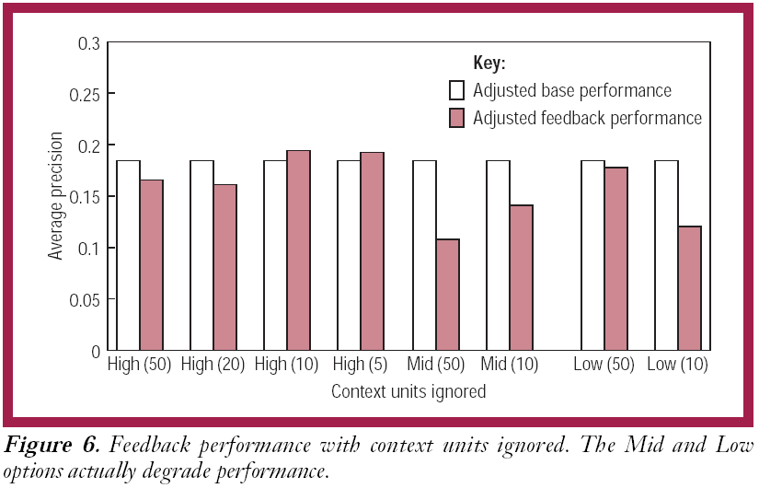
High tf terms are better; it works only when a small number of terms is used!
Dik Lun LEE Department of Computer Science, HKUST Slide <number>

Slide 33
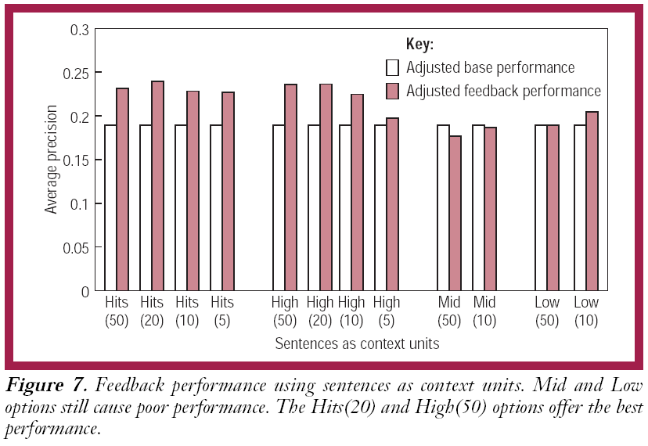
Terms based on context are much better; even LOW yields good result! You can choose more terms: 20 terms and 50 terms for HITS and HIGH
Dik Lun LEE Department of Computer Science, HKUST Slide <number>

Slide 34
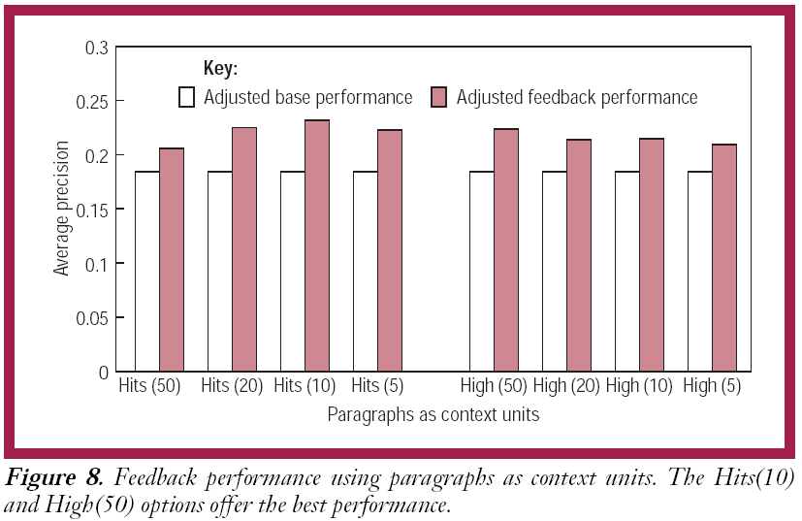
Dik Lun LEE Department of Computer Science, HKUST Slide <number>

Slide 35
Conclusion
Ranking algorithms in a real implementation is hard to predict; what work or won’t work based on theory or intuition may turn out surprising (thought explainable in hindsight) results
Carefully selection of a small set of “theme” keywords is very important for many tasks: clustering, relevance feedback, page/site summary, etc.
Dik Lun LEE Department of Computer Science, HKUST Slide <number>

